Slide 1
HTML
The language for building web pages

Slide 2
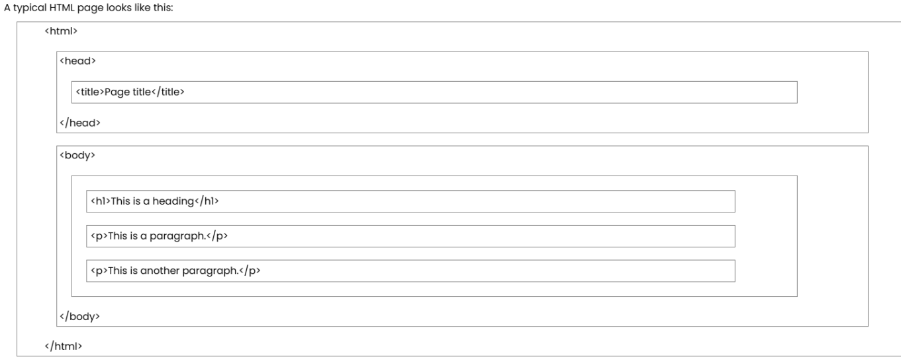

Slide 3
Difference between inline and block elements
A block-level element always starts on a new line, and the browsers automatically add some space (a margin) before and after the element.
take full width from container .
example on block elements :
<div>, <p>, <h1> to <h6>, and <ul>, <footer>,<header>,<article> .
<li>
An inline element does not start on a new line.
An inline element only takes up as much width as necessary.
we use it in block ,to style part of content
example :
<sub> ... as H2O
<sup>.... 2^3

Slide 4
HTML pages Structure,
HTML Structure: Group of elements tell the browser how to display the content.
1- Head
Consist of metadata, external links such as CSS and JS files.
2- Title
Webpage title which appears on the browser bar or tab.
3- Body
Visible content of the webpage (texts, images and other elements).

Slide 5
Header tag HTML
Header tag HTML offers six hierarchical levels of headings, ranging from <h1> to <h6>, each with unique significance. <h1> is the highest level, typically used for the main title or section of a web page, while <h6> is the lowest level, typically reserved for subsections or smaller details within the content. By using these heading tags carefully and hierarchically, web developers can create a visual and structural hierarchy that guides readers through the flow and importance of the content, making it easier to understand and navigate.
Use headings sequentially: It is essential to use headings in a sequential order. Start with <h1> for the main title or section, followed by <h2> for subsections, <h3> for sub-subsections, and so on. This helps maintain a logical and organized structure.

Slide 6
HTML Links
What are HTML links and what are they used for?
HTML Links is an inline element, also known as hyperlinks, which are defined by the <a> tag in HTML, which stands for “anchor.” These links are essential for navigating between web pages and directing users to different sites, documents, or sections within the same page.
The basic attributes of the <a> tag include href, title, and target, among others.
HTML Links – Target Attribute
The target attribute in the <a> tag specifies where to open the linked document. It controls whether the link opens in the same window, a new window, or a specific frame.

Slide 7

Example:
<a href="https://www.groub 3 .com”>Groub 3</a>
In this example, you will see after running it that there is a link called.

Slide 8
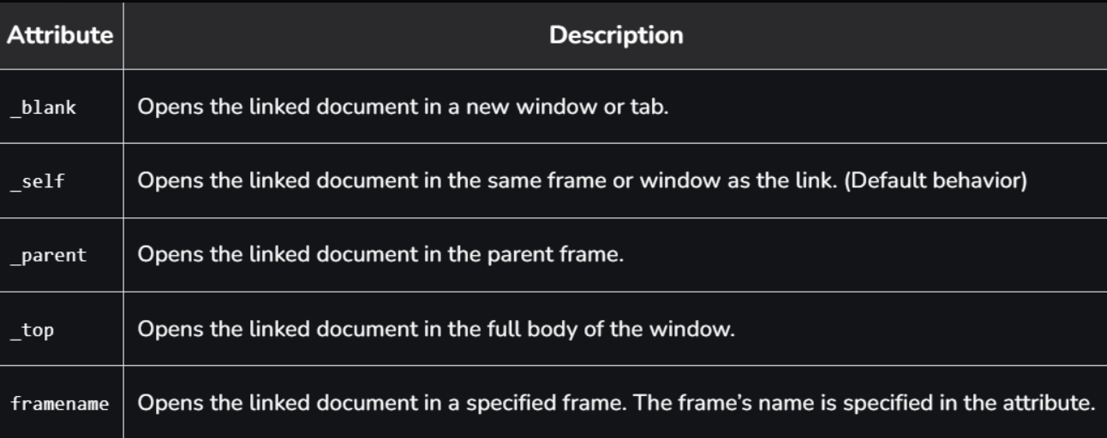
HTML Links – Target Attribute

Slide 9
HTML Image
Images can improve the design and the appearance of a web page.
HTML Images Syntax
The HTML <img> tag is used to embed an image in a web page.
Images are not technically inserted into a web page; images are linked to web pages. The <img> tag creates a holding space for the referenced image.
The <img> tag is empty, it contains attributes only, and does not have a closing tag.
The <img> tag has two required attributes:
src - Specifies the path to the image
alt - Specifies an alternate text for the image

Slide 10
HTML Paragraphs
HTML Paragraphs
paragraph always starts on a new line, and is usually a block of text.
HTML Paragraphs
The HTML <p> element defines a paragraph.
A paragraph always starts on a new line, and browsers automatically add some white space (a margin) before and after a paragraph.
Example
<p>This is a paragraph.</p>
<p>This is another paragraph.</p>

Slide 11
HTML Display
You cannot be sure how HTML will be displayed.
Large or small screens, and resized windows will create different results.
With HTML, you cannot change the display by adding extra spaces or extra lines in your HTML code.
The browser will automatically remove any extra spaces and lines when the page is displayed:
Example
<p>
This paragraph
contains a lot of lines
in the source code,
but the browser
ignores it.
</p>
<p>
This paragraph
contains a lot of spaces
in the source code,
but the browser
ignores it.
</p>

Slide 12
HTML Horizontal Rules
The <hr> tag defines a thematic break in an HTML page, and is most often displayed as a horizontal rule.
The <hr> element is used to separate content (or define a change) in an HTML page:
Example
<h1>This is heading 1</h1>
<p>This is some text.</p>
<hr>
<h2>This is heading 2</h2>
<p>This is some other text.</p>
<hr>

Slide 13
HTML Line Breaks
The HTML <br> element defines a line break.
Use <br> if you want a line break (a new line) without starting a new paragraph:
Example
<p>This is<br>a paragraph<br>with line breaks.</p>

Slide 14
Solution - The HTML <pre> Element
The HTML <pre> element defines preformatted text.
The text inside a <pre> element is displayed in a fixed-width font (usually Courier), and it preserves both spaces and line breaks:
Example
<pre>
My Bonnie lies over the ocean.
My Bonnie lies over the sea.
My Bonnie lies over the ocean.
Oh, bring back my Bonnie to me.
</pre>

